Slide 1



Probabilistic Forecasts for Global Models: Empirical Insights from Gradient Boosted Decision Trees
Filotas Theodosiou, Yves R. Sagaert, Liselot De Vlieger
¹VIVES University of Applied Sciences, Kortrijk, Belgium
Notes:
Hi everyone, I am Filotas Theodosiou, I am a Data Scientist and Researcher at VIVES University of Applied Sciences and this is our joint work with Yves Sagaert and Liselot De Vlieger.

Slide 2
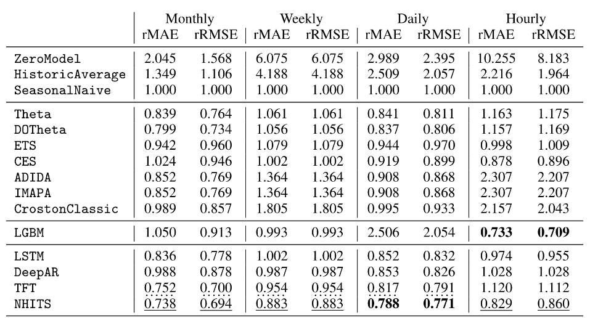
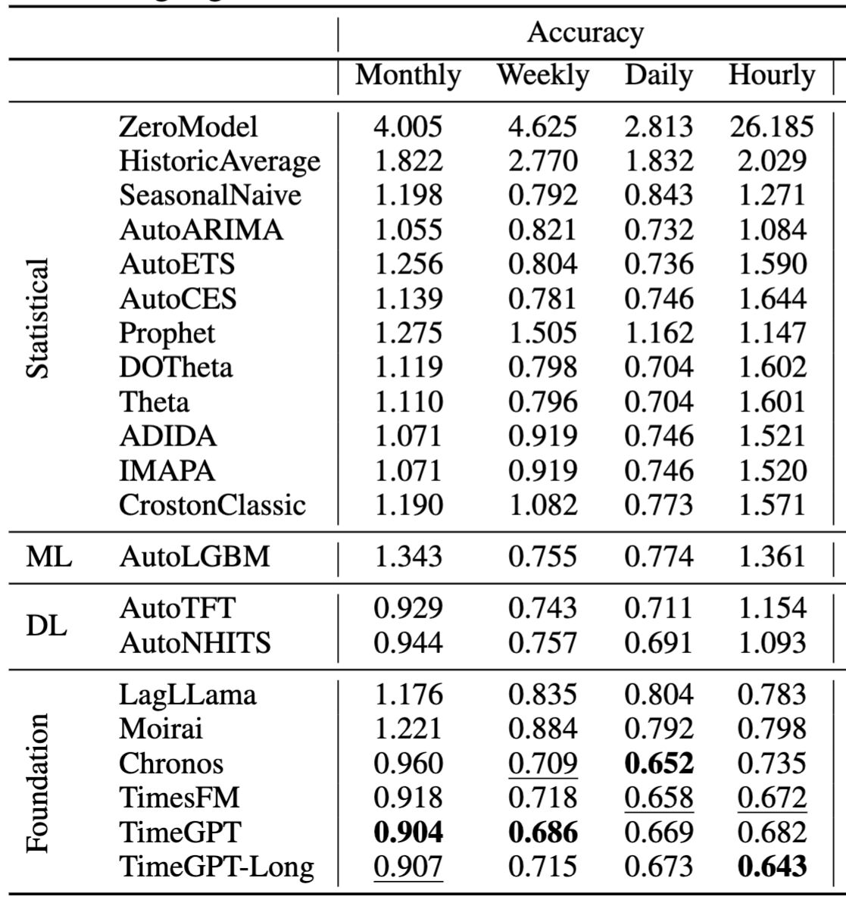
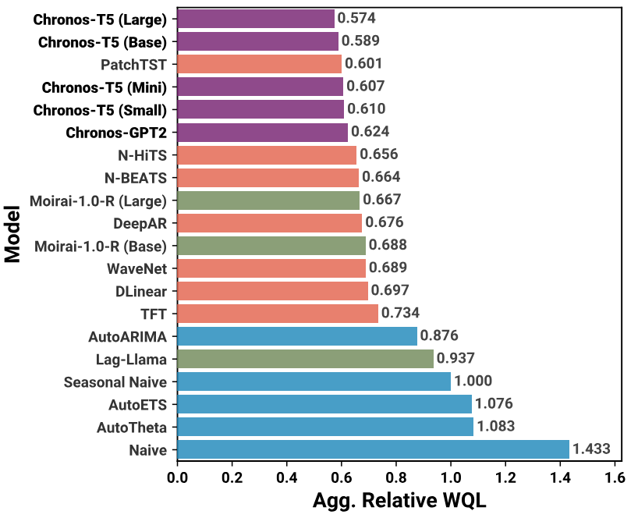

Introduction. Lets Talk Probabilistic.
In practice we (usually) don’t consider point forecasts.
Yet, we use them for model comparison. (Yes, we have to)
However, accuracy of a decision is not equal to the accuracy of a point forecast.
We need to evaluate probabilistic forecasts.
https://github.com/Nixtla/nixtla?tab=readme-ov-file - https://github.com/Nixtla/nixtla/tree/main/experiments/foundation-time-series-arena
Kourentzes, Nikolaos and Svetunkov, Ivan and Trapero, Juan R., Connecting forecasting and inventory performance: a complex task (July 1, 2021). Available at SSRN: https://ssrn.com/abstract=3878176 or http://dx.doi.org/10.2139/ssrn.3878176
Salinas, David, et al. "DeepAR: Probabilistic forecasting with autoregressive recurrent networks." International journal of forecasting 36.3 (2020): 1181-1191.
Ansari, Abdul Fatir, et al. "Chronos: Learning the language of time series." arXiv preprint arXiv:2403.07815 (2024).
Notes:
Its known that in practise we rarely use point forecasts
Model comparisson: Fast and easy way to do it.
We need to evaluate probabilsitic

Slide 3


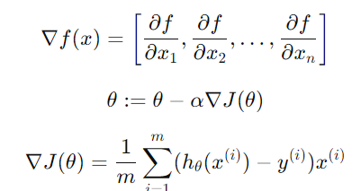
Introduction. Gradient Boosted Decision Trees (GBDTs)
The scroll of Gradient!
Valia Calda, Pindus Mountain Range, Greece
Notes:
But Gradient Boosted Decision Trees.

Slide 4
Introduction. Why Gradient Boosting Decision Trees?
Low complexity
High complexity
Non-Parametric
Statistical Models
GBDTs
Deep Neural Networks
Efficiently Globally Scalable
The motivation?
Mediocre (parametric & modelling) complexity while scalable!
We know that they work.
People in the industry know that they work.
Not as fancy and “cool” as Neural Networks.
And this difference might threaten to open the gap between Research - Practice
Makridakis, Spyros, Evangelos Spiliotis, and Vassilios Assimakopoulos. "M5 accuracy competition: Results, findings, and conclusions." International Journal of Forecasting 38.4 (2022): 1346-1364.
Januschowski, Tim, et al. "Forecasting with trees." International Journal of Forecasting 38.4 (2022): 1473-1481.
Wellens, Arnoud P. and Boute, Robert N. and Udenio, Maximiliano, Simplifying Tree-based Methods for Retail Sales Forecasting with Explanatory Variables (September 8, 2022). European Journal of Operational Research,
Notes:
So GBDTs are globally scalable while not being so complex as Neural Networks. That means they can be used and maintened more easilty
We also know that they work
People in the industry know they work

Slide 5
Introduction. Aim, Motivation, etc.
Motivation:
Limited research results on probabilistic forecasting using GBDTs.
Potential gap between academia – industry.
Aim:
Define different estimators for probabilistic forecasts.
Apply them using GBDTs.
Evaluate them on 4 real world case studies coming from the food demand sector.
Discuss the result implications.
Notes:
- Limited research results on GBDTs
Why? Because not properly defined methods
Then no correct benchmarking. Thus the gap.
Aim
Discuss implications and how can they further be generalized.

Slide 6
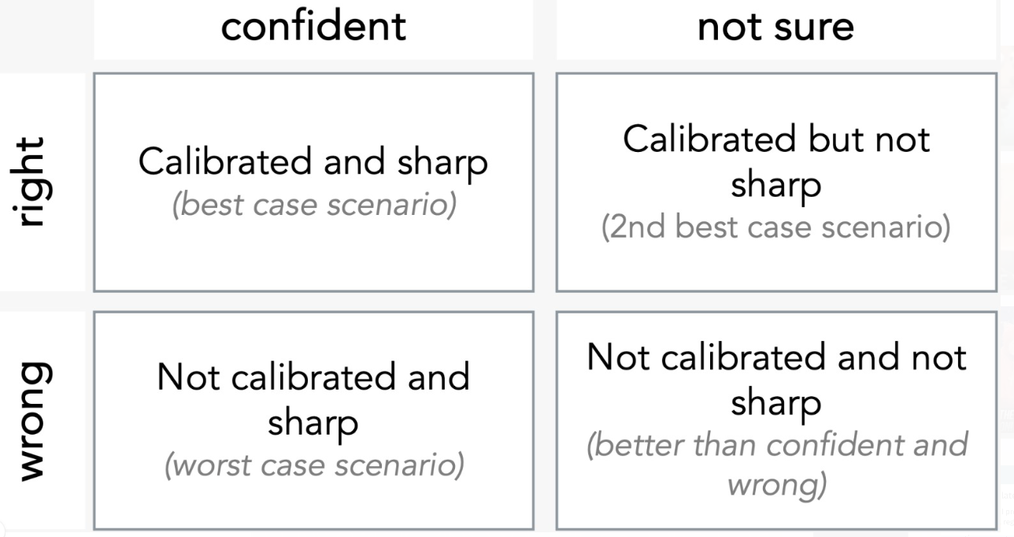
Methodology. What Makes a Good Prediction Interval.
“Maximize the Sharpness subject to Calibration”
Gneiting, Tilmann, Fadoua Balabdaoui, and Adrian E. Raftery. "Probabilistic forecasts, calibration and sharpness." Journal of the Royal Statistical Society Series B: Statistical Methodology 69.2 (2007): 243-268.
https://www.linkedin.com/in/leonidas-tsaprounis-302ba882/
Notes:
What we want in decision making is first of all a calibrated prediction interval that is as sharp as possible.

Slide 7
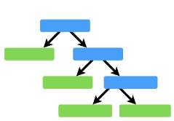
Background! GBDTs in a (rather small) Nutshell.
Boosting
Same idea across models (LGBM, XGBoost, Catboost)
Different regularization + tree expanding methods
Get prediction
Calculate error
Predict Error
Calculate Error
Predict Error
Calculate Error
GBDTs
Gradient descent works on the feature space.
Accurate, holistic description of the problem.
Features & hyperparameter optimization.
Neural Networks
Gradient descent works on the parameter space.
Affine transformations of feature space.
Architecture optimization.
Building an information feature space is a priority.
(More on that later)
Notes:
I am not going to explain how GBDTs work. Since all talks regard these types of models I am going to skip this slide.
I will only say that building an informative feature space is a priortiy if you want to have high accuracy.

Slide 8
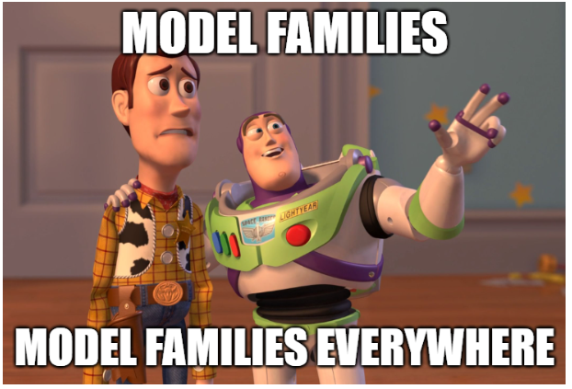
Methodology. Different Families of Probabilistic Methods.
Methodology.
Three main families
Direct Optimization
Bootstrap-Based Methods
Empirical Methods`
Notes:
We have a total of 3 model families. One can argue for two but I will stay with 3.
We have direct optimization where we directly train a GBDT on a property or a parameter of a distribution other than the mean/median
We have boostraping-based methods where we create multiple future paths by saampling from the residuals
And we have empirical methods where we use validation errors to make up for the future errors.
One can say bootsrtraping is an empirical method. I agree but here I have splitted them because bootstraping is more widely applied.

Slide 9

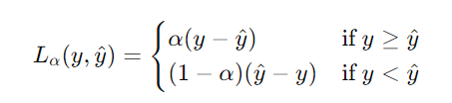
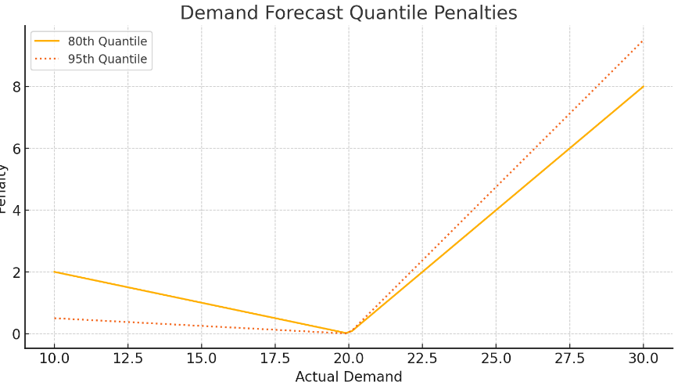
Direct Optimization. Quantile Regression.
Minimize pinball loss for a specific quantile.
Straightforward, widely applied, flexible assumptions
Requires fitting multiple models for multiple quantiles (can get slow)
Does not guarantee monotonicity
And what about calibration then??
Global Learning might miss local dependencies when directly optimized.
Asymmetric nature of pinball loss.
Model misspecifications
Heteroscedasticity
Notes:
Lets start with something simple and well-known. We have quantile regression. So instead of optimizing on mean/median with mae or mse we optimize on a specific quantile using pinball loss.
It’s a rather straightforward approach with flexible assumptions.
The problems are that it can be slow for multiple quantiles, it does not guarantee montonicity (meaning a higher quantile would be larger than a smaller on).
Most importantly when trained globally, in practice we have calibration issues. That means that for some time series the prediction interval is not calibrated.
There are some reasons for that with the most important being the asymmetric nature of pinball loss when paired with global learning.

Slide 10
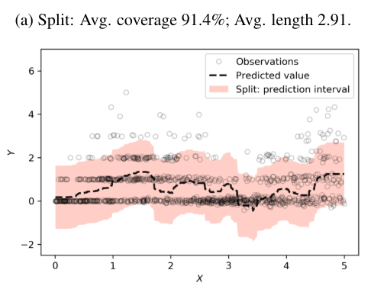
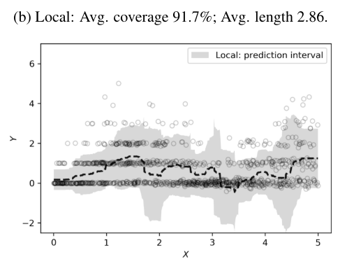
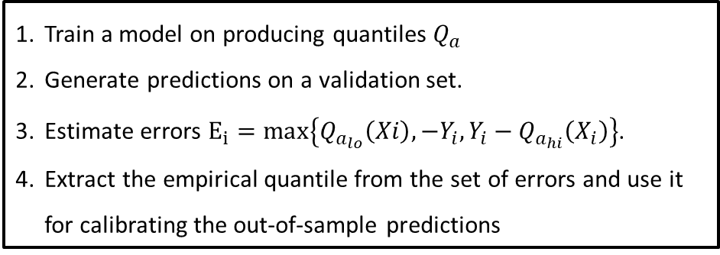
Direct Optimization Calibrated Quantile Regression.
Conformalized Quantile Regression: Adapt to local data variability
Train a model on producing quantiles $Q_{a}$
Generate predictions on a validation set.
Estimate errors $E_{i}=\max\left\{Q_{a_{lo}}\left(Xi\right), −Y_{i}, {Y_{i}−Q}_{a_{hi}}\left(X_{i}\right)\right\}$.
Extract the empirical quantile from the set of errors and use it for calibrating the out-of-sample predictions
Romano, Yaniv, Evan Patterson, and Emmanuel Candes. "Conformalized quantile regression." Advances in neural information processing systems 32 (2019).
Notes:
A quick fix coming from machine learning literature is conformalized quantile regression.
Where as you can see we use some of the errors (the not – included) observations to calibrate our interval better.
How we do that? Its an empirical method which I am going to touch more later. In a nutshell.
We get some prediction on a validation set, we estimate the errors and we use them to calibrate our next out-of-sample predictions.

Slide 11
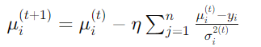

Direct Optimization Distributional GBDTs.
Optimize the parameters of a distribution using Negative Log Likelihood
Total Trees
“Borrowed” from Deep Learning Literature.
Assume an underlying distribution.
Derive Gradients and Hessians for each distributional parameter.
Train seperate groups of trees for each parameter
During each boosting round, update both sets of tree simultaneously.
Trees for μ
Trees for σ
Simultaneous update
Update sets of trees using corresponding Hessians/Gradients
März, Alexander, and Thomas Kneib. "Distributional gradient boosting machines." arXiv e-prints (2022): arXiv-2204.
Notes:
Then we have distributional GBDTs.
This is inspired from literature from Neural Networks that started from the DeepAR paper where gradient descent was applied using negative-log-likelihood on the distributional parameters of an assumed distribution.
This is a dream I had to do apply it for GBDTs too. GBDTs are optimized on one specific output while Neural Networks are more flexible.
So I came across this paper with this very smart trick.
First we assume a distribution, then we split the total number of trees into trees that will work on μ and trees on σ.
For each set of trees we esrtimate Hessian Gradients and then take them and apply negative-log-likelihood.
Pretty smart. Recommend a good read on the paper.

Slide 12
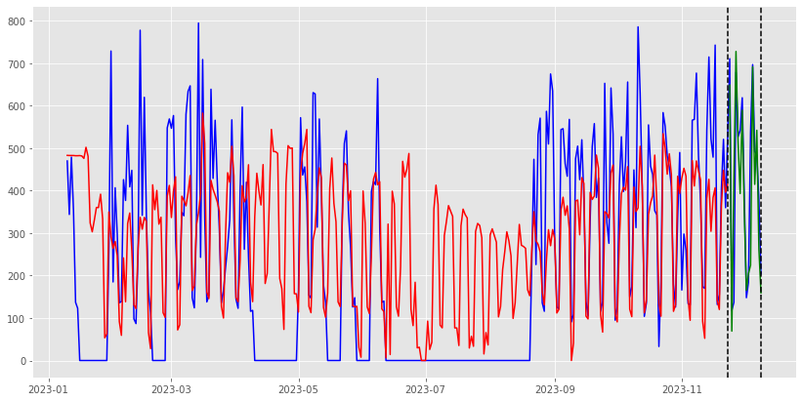
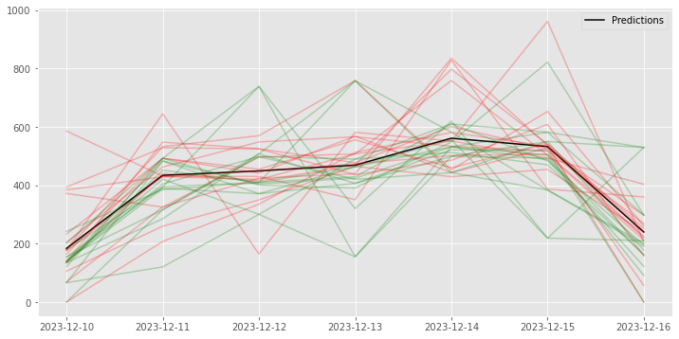
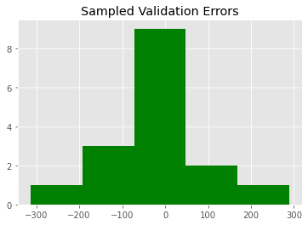
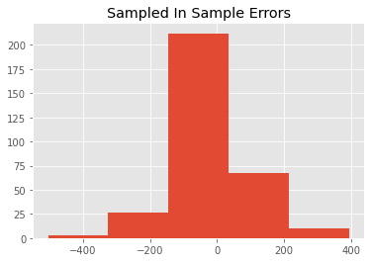
Bootstraping. Rather Straighforward (Watch for Intermittency).
Notes:
And then we sample from these collections of errors to get the a distribution of predictions!

Slide 13
Bootstraping. Important Notes.
Generate multiple predictions by sampling from a collection of past errors
Assumes errors are iid with constant variance
Assumes future errors will be like past errors
How to sample?
One-step-ahead errors
Matches the recursive forecaster
Not representative on longer horizons
Per horizon errors
Quantify uncertainty per horizon
Limited data to sample
Where to sample from?
In-sample errors -> not representative
Validation errors -> limited
Alternative: Non-uniformly weighted sampling
Notes:
So what we are doing is we are sampling from past errors.
We are assuming errors are iid with constant variance and that future errors will be identical to past ones.
The question now becomes, where to sample from? Do we sample from in-sample-errors? They are not representtive as they have been used for training.
Do we sample from validation errors? They are less than the in-sample errors.
One alternative we are using to have non-uniformaly weighted sampling. That means sample from both distributions but have a higher selection weight on validation sets.
The other question is do we use residuals? One-step-errors or errors per horizon?
One-step-ahead errors match the recurisce nature of LGBMs but might not be representive for future horizons.
On the other hand, the per-horizon errors are more limited.

Slide 14
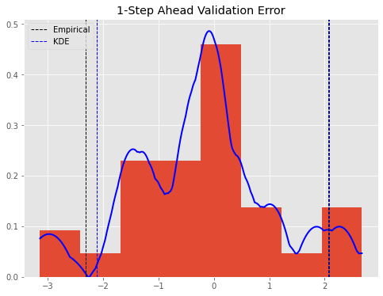
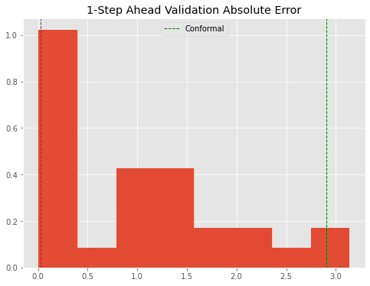

Empirical Methods. Non-Paremetric, Model – Agnostic.
Extract quantiles from the distribution of errors on a validation set
Prediction - Interval
Direct Empirical: Extract a, 1-a quantiles from the errors’ distribution.
KDE: Estimate Kernel Density of the errors. Then extract a, 1-a quantiles.
Conformal Predictions : Extract 1 - a/2 quantile from the absolute errors distribution (More variations).
$$\hat{y}±Q_{1−a}F(y)$$
Trapero, Juan R., Manuel Cardos, and Nikolaos Kourentzes. "Empirical safety stock estimation based on kernel and GARCH models." Omega 84 (2019): 199-211.
Stankeviciute, Kamile, Ahmed M Alaa, and Mihaela van der Schaar. "Conformal time-series forecasting." Advances in neural information processing systems 34 (2021): 6216-6228.
Notes:
We want to cover the middle of the distribution and leave the other part out -> point at the distribution nwhere you show that.
Finally we have empirical methods. Here we simply extract quantiles from the distribution of validation errors and sume them to the point forecasts!
The question becomes which distribution and how to extract?
- We have the direct method where we just take the a and the 1-a quantiles
- We have the KDE method where we estimate the kernel density and then extract the errors. It creates a more smooth representation
- And finaly we have conformal predictions (or at least on variation) where we extract 1-a/2 quantile from the absolute distribution.

Slide 15
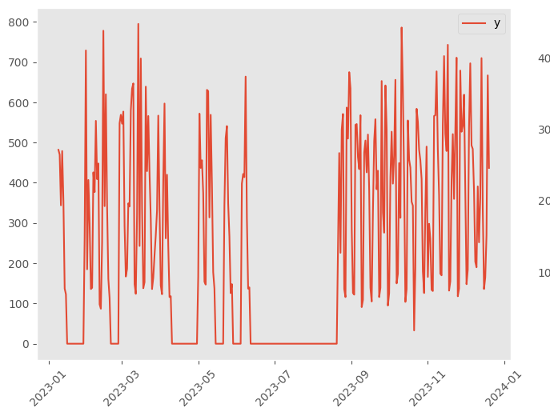
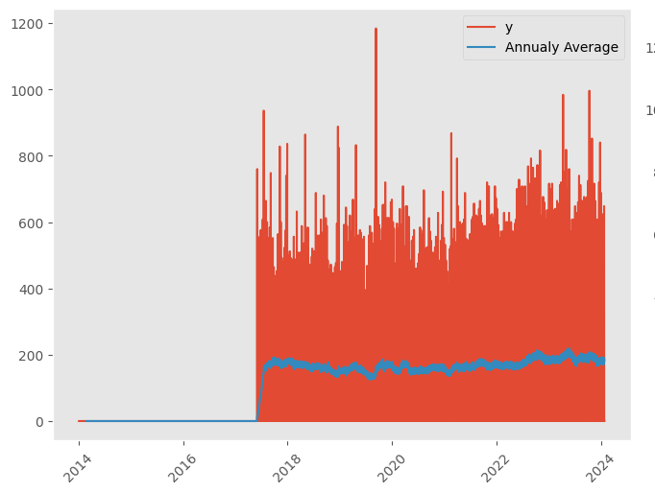
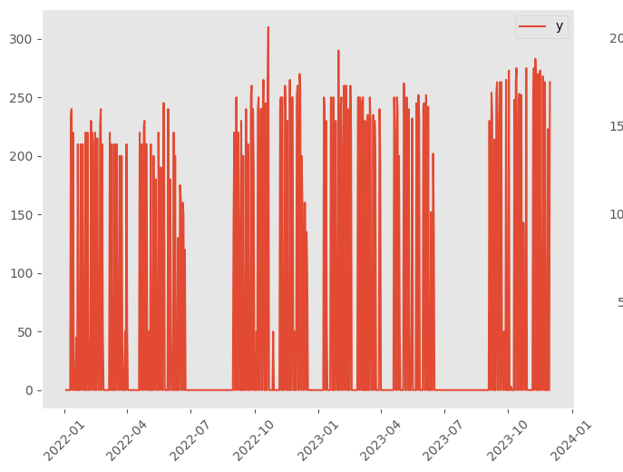
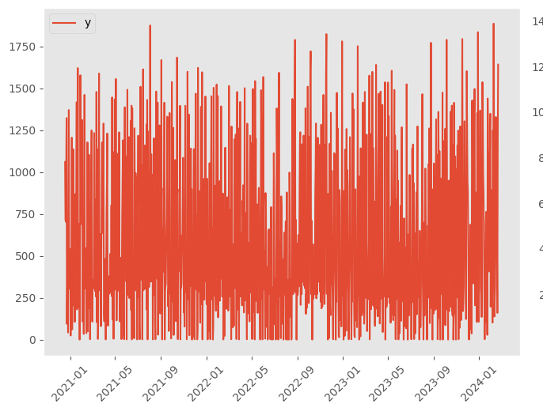
Experimental Design. Case Studies from the Food Sector.
We partner with food companies to tackle food waste.
Daily demand of ready-to-eat meals.
Forecast horizon is 7 days.
A total of 5 rolling origins.
Newsvendor problem
We use LGBM as the underlying GBDT model.
16 Time series, 11.5 months
55 Time series, 8 Years
We evaluate on:
Prediction Interval Properties
Scaled Pinball Loss (Scaled with In-Sample-MAE)
Continuous Ranked Probability Score (CRPS)
Coverage and Width.
Inventory Simulations.
254 Meals, 8 Months
55 Meals, 23 Months
Notes:
We partner with companies from the food sector to tackle food waste. We forecast the daily demand of ready-to-eat meals for a total of 4 companies.
Its a newsvendor problem as there is no stock.
Forecast horizon is 7 days and we perform an experiment with 5 rolling origins.
We evaluate the different methods on Prediction Interva Metrics like Scaled Pinball Loss and CRPS, we also evalaute on coverage, width and perform inventory simulations.

Slide 16
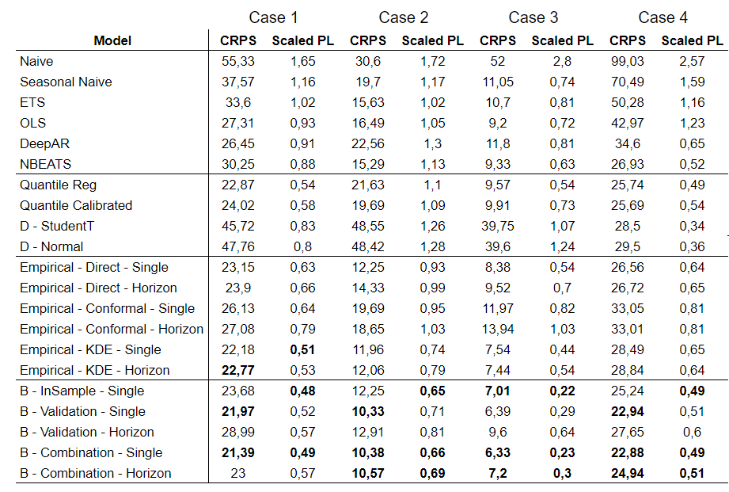
Results The Typical Slide with a Table.
GBDTs outperform benchmarks.
Bootstrapping stands out.
KDE performs well. A good, faster alternative
Quantiles and (conformal) quantiles do not justify their optimization time
Something did not work with distributional models.
Note: Benchmarks’ hyperparameters optimized automatically
Notes:
- What we first observe is that GBDTs outperfom all benchmarks. We different and diverse set of baselines.
However it should be noted that hyperparameters of the benchmarks are automaticaly optimized and we did not spend as much time as optimizing GBDTs.
- We see that bootstraping ande KDE stand out on most cases. Interestignly the combiantion methods of Bootstraping is always in the top three places.
- On the other hand distribution methods did not work so well here. Also quantile regression and conformalized quantile regression did not validate their optimization time.
They might be simple but other methods are faster and produce better results

Slide 17
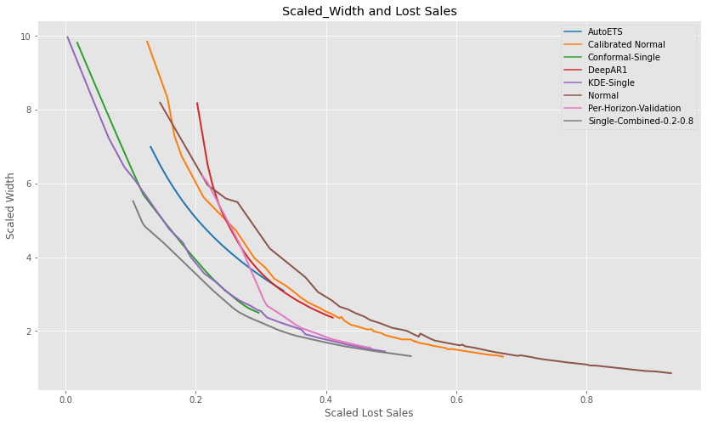
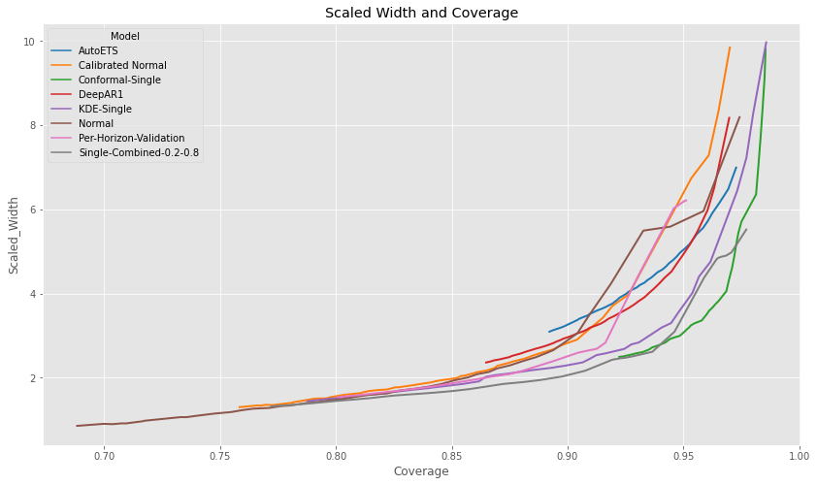
Results Inventory Simulations.
Notes:
Not enough time
Three methods stand out, Boostrap combinations, KDE and Conformal.
While Conformal did not score very high on prediction interval evaluations it shows the highest coverage.
This is aligned with conformal predictions literature where they ensure that they will achieve calibration.
On the other hand Bootstraping and KDE sacrifice some coverage but do well in terms of scaled width and lost sales.
So its a more balacned alternative

Slide 18
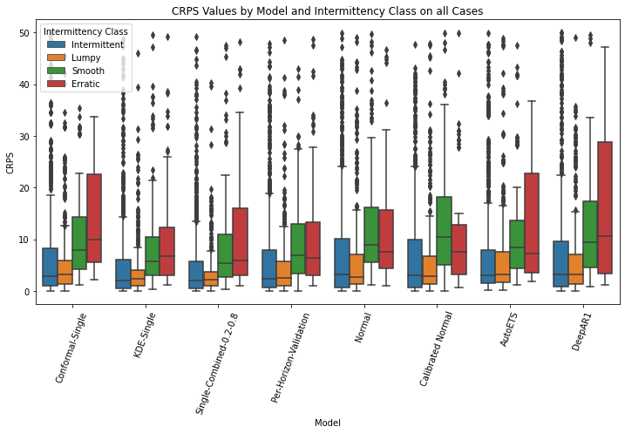
Results What About Intermittency.
Forecasting intermittent demand is hard (see outliers)
Quantile regression fails on the difficult demand patterns (calibrated too)
KDE & Bootstrapping perform much better (adapting to local properties!)
Especially on erratic and smooth (remember high errors on non-sales period?)
KDE seems more robust across different cases
Syntetos AA, Boylan JE and Croston JD (2005) On the categorization of demand patterns. J Opl Res Soc 56: 495–503.
Notes:
Next we compare on different demand patterns.
What we observe is that forecasting intermittent demand is indeed hard for all methods.
Quantile regression fails most in there. What we assume it that it fails to seperate the differences between demand patterns. Maybe different clusters per demand pattern or more data would work here
The same for DeepAR.
On the other hand, KDE and Boostraping work better because the can more easily addapt to local properties by considering local errors. They seem to better combine global learning with local adaptability. And this is more evident on erratic and smooth time series where we dont have these fat tails of extreme errors on no sales periods
Finaly KDE seems to be the most robust accross all different cases.

Slide 19
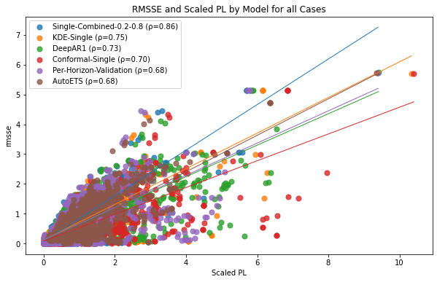
Results Are Accurate Forecasts Enough?
Highest correlation on Bootstrapping and KDE.
Adaptive performance of local properties balances global optimization.
Notes:
To build further on our assumption that these methods adapt better on the local characteristics of each time series we investigate the correlation between point accuracy and Scaled Pinbal Loss.
We see the highest correlation on Validation and KDE.
Wbelieve this has to do with the smooth coordination between global learning and adaptability to local errors for calibration!
We are going to investigate this further by breaking down into if its the specific propertirs of Pinball Loss and where the gains are coming from -> Better calibration or sharpness?

Slide 20
In Summary: Your Main Takeaways.
Non – Parametric Methods (KDE and Bootstrapping) are paired well with Global Learning.
Adapting to Local Properties.
Bootstrapping performs the best -> possibly due to higher sample size.
KDE (smoothly models the whole density distribution) is a good, - faster – alternative.
Most robust across intermittent levels & highest correlation with point accuracy.
Other Non-Parametric (Direct Empirical and Conformal) might work better with a larger sample size.
Conformal Predictions can be used when calibration has the highest importance.
Direct methods need to be used with caution
Quantile regression works well on smooth and erratic but not on difficult demand patterns.
Plus its slow for multiple quantiles.
Distributional fitting requires more careful tuning (slowest method due to optimization process)
And please don’t forget combinations ;)
Wang, Shengjie, Yanfei Kang, and Fotios Petropoulos. "Combining probabilistic forecasts of intermittent demand." European Journal of Operational Research (2024).
Notes:
Ah also please dont forget combinations as mentioned in this paper. They tend to work well on intermittent patterns.
But choose your combination estimators wisely.

Slide 21
In Summary: To Say Goodbye:
GBDTs are sometimes overlooked when we compare forecasting models.
Yet, by now, they are battle-tested and we know they work (mainly when globally trained)
We define and benchmark different estimators for getting probabilistic forecasts with GBDTS
(As always) Final model selection depends on multiple factors.
Future work: Expand analysis to decision making impact.
“Ingredients-level” inventory management to tackle food waste.
Notes:
And to say goodbye.
Main point is that there is not a single model that is the best on all tasks and the final selection should depend on multiple factors.
What we did here is we defined and combined different estimators for probabilistic forecasts using LGBMs
GBDTs are good, if they are tuned properly, so don’t overlook them
The main takeaway is that there is no universaly better method to be used on all cases. Final method selection depends on multiple factors.
In the future we will explore the implications of these different methods in inventory management practises.

Slide 22



Thank you for your attention
Questions ?
filotas.theodosiou@vives.be
https://github.com/FilTheo
https://www.linkedin.com/in/filotas-theodosiou/
©mrsiraphol

